Slide 1
AOPP MPhys Overview
Don Grainger

Slide 2
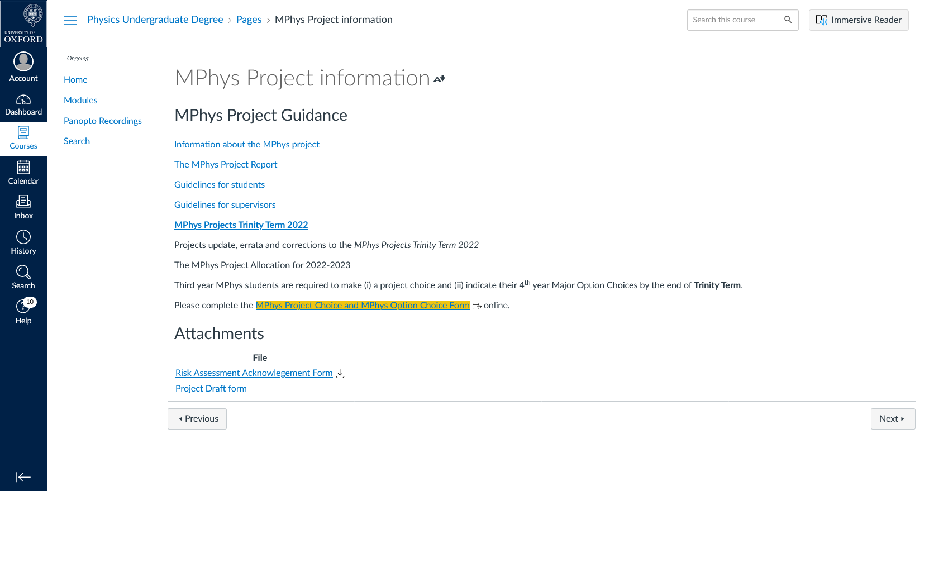
This is the MPhys Bible: https://canvas.ox.ac.uk/courses/67877/pages/mphys-project-information?module_item_id=1255373

Slide 3
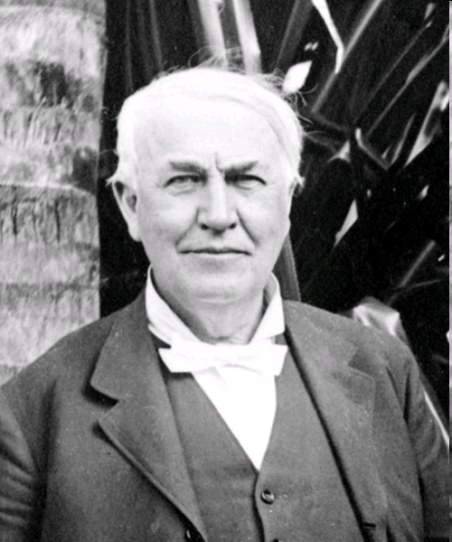
Genius is one percent inspiration, ninety-nine percent perspiration.
Thomas Edison, 1903

Slide 4
Doing the Project
An MPhys Project is not like any lecture or lab work you have done before, it is about being a physicist
you have to work out how to solve problems
you have to validate (check) you approach and progress
Treat it like a job – expect to do at least a 40 hour week; hours flexible but should be here during core of the day (10 am – 4 pm)
Learn to research efficiently
work in phase with people you need to talk to
try and work things out yourself and if you can’t …
use books, papers (know about web of science ; https://www.webofscience.com/wos/woscc/basic-search)
ask your peers, postdocs & supervisor

Slide 5
Keep a lab book – make notes as you go along
Meet weekly with your supervisor
When you produce plots it is often a good idea to separate the production of data from the plotting. This way if you need to replot the data you don’t have to regenerate it.
you can use S52
coffee is at 11 on the roof – it is an excellent time to catch people, meet others in the department and ask questions
you should attend EODG meetings. These are at 10.00 on Thursday in S52

Slide 6
Nominal Timeline
Trinity Term, Weeks 3-8 | Background Reading Learn Python Set-up Latex report, complete background chapter
Hilary Term, Weeks 1-8 | Do Project
Week 8 Wednesday** | Hand in full 1st draft of MPhys report to your Post-Doc supervisor
Week 9 Monday | Comments Back From Post-Doc Supervisor
Week 9 Friday** | Hand in full draft of MPhys report to Don
Week 10 Friday | Comments Back From Don
Trinity Term 2023, Week 1 | MPhys project reports handed in.
You might want to negotiate when your hand in your 1st draft and when your supervisor will give you feedback
But you MUST give yourself time (at least a week) to make corrections

Slide 7
The structure of your report should be something like:
Contents
Introduction
Outline the problem you are going to address
State specific objectives
Give background science
Summarise the current state of knowledge
Method
A description of the instrument/model you are going to use.
Results
Describe what you have done
Make sure you do an error analysis
At the end, summarise what you have found out
Conclusions
Summarise your project
How has the uncertainties of the science been reduced
Have you achieved the objectives stated in the introduction
Future work: What you would recommend to be done next
Acknowledgments
who helped
References
Appendices (if required)
Usually bits of theory or maths that are known (and are not your work) but are added for easy reference for the reader.

Slide 8
To judge the level of complexity, agree to swap with another student – if they can’t understand what you have written then it is not clear enough
Make sure you have agreed the structure of your report with your supervisor by the end of term and perhaps shown him/her a couple of pages to get some initial feedback
Your final draft should be as close to perfect as you can make it.
Previous project reports are on the EODG website. (www.atm.ox.ac.uk/group/eodg/reportsandtheses.html)

